Slide 1
Predicting Control Energy Volumes for Grid Stability
Team BKW – <NAMES>

Slide 2
Current BKW model
<Input from the BKW Colleague>

Slide 3
Challenge
Develope a predictive model to forecast control energy activations for grid stability.

Slide 4
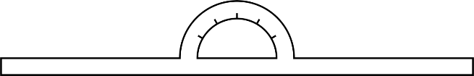
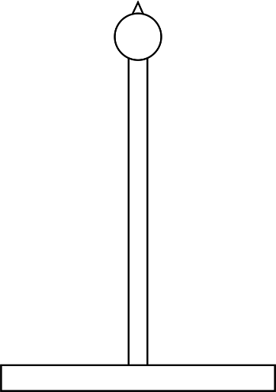

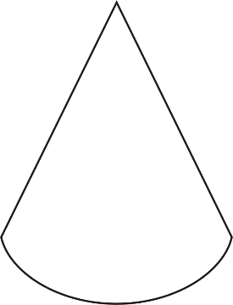



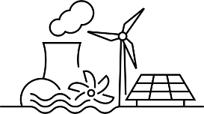
Control Energy Activations?
50,0 Hz
1
2

Slide 5
Control Energy Activations?
Primary
Secondary
Tertiary

Slide 6
Control Energy Activations?
Primary
Secondary
Tertiary

Slide 7
What is the Data about?
Some Data information
First patterns we saw

Slide 8
Our two branches
Branch one: Day-ahead forecast <input a image with an arrow to a date symbol>
Branch two: long-term (seasonal) forecast <image of a calendar marked with some dates>

Slide 9
Day-ahead forecast
<images, text, data>

Slide 10
Long-term forecast / Patterns
<If we have some images, patterns model>

Slide 11
Model we created
<info about the model>

